Slide 1
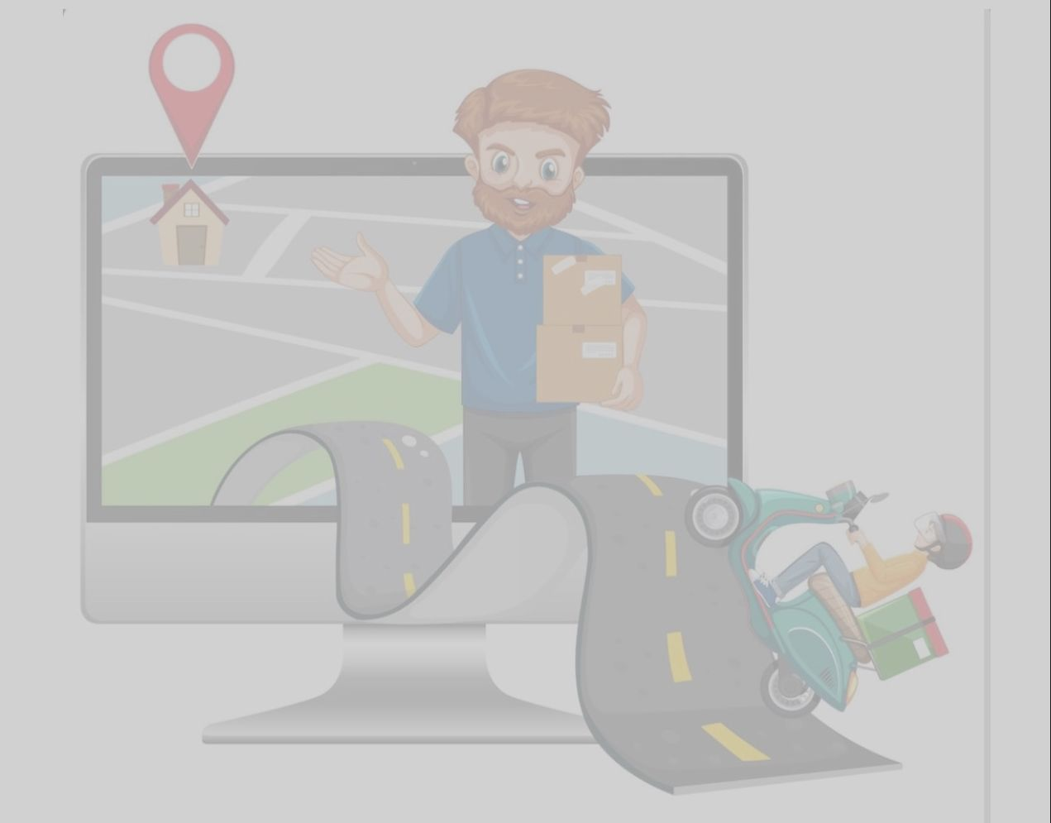
SMART BIKE USING IoT AND DEEP LEARNING
TEAM – 9
19K41A05F0 - B. ARCHANA
19K41A05G7 - R. AKSHITHA
19K41A05D2 - K. AKSHAYA
19K41A05G6 - R. SUDHAN JEE
UNDER THE GUIDANCE OF
K. RAVI CHYTHANYA

Slide 2
ABSTRACT
Every day there is an increase in the number of vehicles on the road. Additionally, technology has undergone development on vehicles that have accelerated speeds. We don't take safety seriously. The usage of helmets can reduce 69% of head injuries in an accident according to WHO. The project's main aim is to develop a smart bike that ignites or starts only when the rider wears a helmet and also checks the condition of the rider, and has a global positioning system.

Slide 3
INTRODUCTION
A motorcycle is a basic transport used by the public in different countries. In recent years, road accidents have rapidly increased, causing fatal injuries. The occurrence of accidents cannot be controlled, but we can prevent life-threatening injuries by wearing helmets.
Drowsy driving has been a significant cause of horrible accidents causing deaths and injuries. Over 6000 fatal crashes each year may involve a drowsy driver.
GPS monitoring has grown in popularity among companies and individuals who want to follow the whereabouts of their assets or cars in real-time, keep an eye on their movements, and streamline their business processes.

Slide 4
OBJECTIVES
The main objective of this project is to ensure the driver wears a helmet while he/she is driving, tries to prevent accidents when the driver feels drowsy, and automatically identifies, and tracks the location of the vehicle or people in real-time.

Slide 5
BENEFICIARIES
The number of accidents that occur will be reduced through a drowsiness detection system, if the driver met with an accident then the probability of death or head injuries will be less. The recovery rate of theft bikes will range high with a real-time location tracking system.

Slide 6
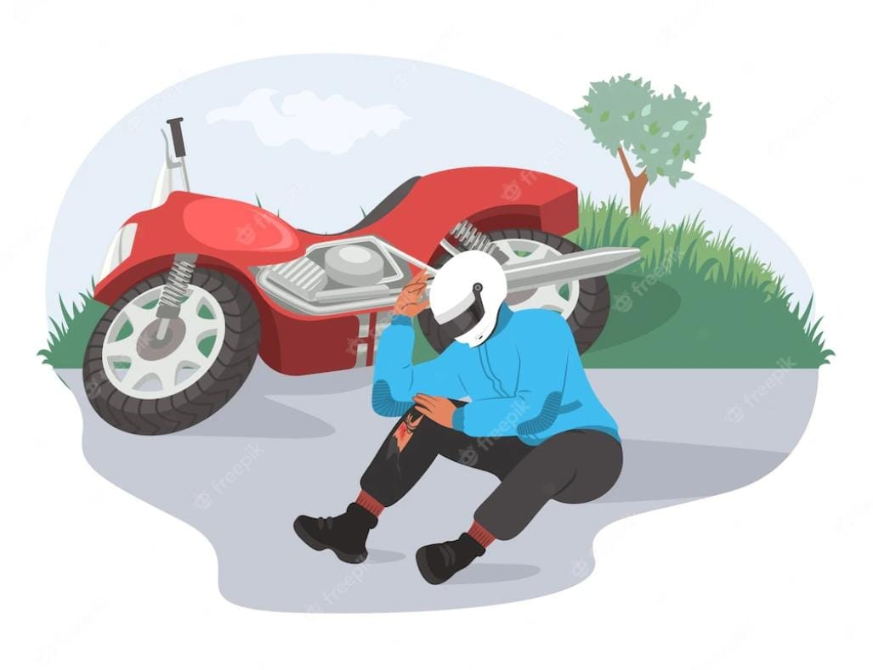
PROBLEM STATEMENT
In India, the lack of wearing a helmet is responsible for 70–85% of motorist deaths that result from accidents. We cannot control the occurrences of accidents but taking precautions to avoid life-threatening injuries due to road accidents is in our hands - by wearing helmets.
Most of the time the drivers would lose their alertness and meet with unfortunate accidents. This loss of the state of alertness is due to the drowsiness of the driver.
In recent times, bike theft has become a common issue. Every year lakhs of bikes were stolen and have the lowest recovery rate of 54.5%.

Slide 7
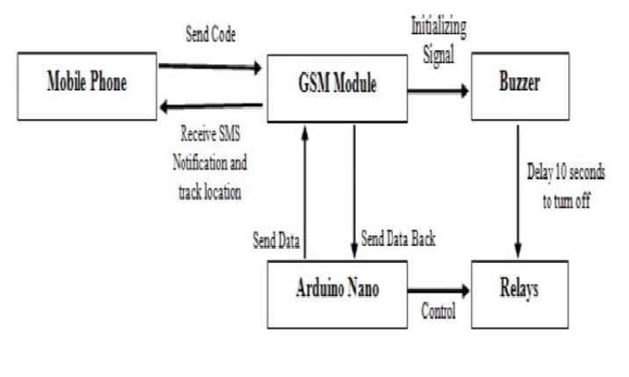
EXISTING SYSTEMS
MOTORCYCLE SHUT-OFF DEVICE
The Motorcycle Engine Shut-off Device was designed to turn on/off the engine of the motorcycle through Short Message Service (SMS), and track the location of the motorcycle in real-time.
The device was fabricated as designed using locally available materials such as Arduino Nano, SMS module, GPS module, and SIM card.

Slide 8
DEEP-LEARNING BASED SAFETY HELMET DETECTION USING ON CNN
This paper depicts about developing an real-time detection of safety helmet i.e; whether the construction workers wears helmet properly or not at the construction site using Deep-Learning methods (CNN).
Mobile Net algorithm that is based on CNN is used to train the model with accurate value. The proposed model provides an opportunity to detect the helmets and improve construction safety management on-site.

Slide 9
DRIVER DROWSINESS DETECTION SYSTEM FOR VEHICLE SAFETY
The paper published in 2019 titled "Driver Drowsiness Detection System for vehicle safety" is an automated safety system designed to scrutinize the eye blink. It focuses on three unique ideas to prevent accidents: blink of an eye using an IR-based eyeblink sensor, whether the driver has drunk or not using an MQ-3 alcohol sensor, and tilt sensor detecting fall. All sensors are under the control of microcontroller LPC2148.

Slide 10
LIVE TRACKING SYSTEM
This project aims to develop an application to track the real-time location of children through SMS using GPS and network providers. SMS is best for communicating and receiving alert messages, and if GPS does not find satellite signals, the application uses a network provider to track the location.

Slide 11
PROPOSED METHODOLOGY
HELMET DETECTION SYSTEM
If a motorcycle rider doesn’t wear a helmet then the internal circuit of the motorcycle will not be closed, and the rider won’t be able to start the bike. If the rider wears a helmet then the internal circuit will be closed and the driver will be able to start the bike. If a person is wearing a helmet and if the driver removes the helmet while driving then the circuit will be opened after a time delay and the engine will be stopped.
We use Convolutional Neural Network, a machine learning model to detect the riders helmet.

Slide 12
MODEL: CNN ALGORITHM
The helmet ,driver drowsiness detection is done using CNN machine learning model. A CNN is a network architecture for deep learning algorithms and is specifically used for image recognition. The dataset used to train this model is collected from google.
And this model is loaded into a raspberry pi module. The camera sends the visuals of the rider and based on the visuals the ML model works. This model classifies whether the motorcycle rider is wearing helmet or not. And also detects the condition of the rider whether the eyes are opened or closed and further classifies.

Slide 13
DRIVER DROWSINESS DETECTION
If a motorcycle rider feels drowsy or uneasy while riding the motorcycle, there is a maximum possibility of occurrence of accidents. In order to prevent accidents a buzzer starts beeping when the camera module detects the condition of the rider based on the closing and opening of eyes under various lighting conditions.
We use the Inception V3 algorithm, a deep learning model to detect the condition of the rider.

Slide 14
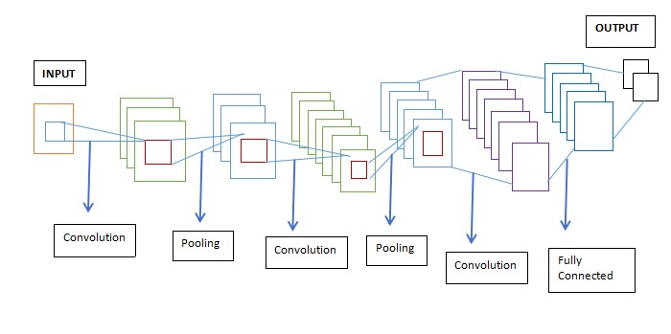
MODEL: INCEPTION V3 ALGORITHM
The Inception V3 is a deep learning model based on Convolutional Neural Networks, which is used for image classification. The inception v3 model has a total of 42 layers and a lower error rate than its predecessors. The model itself is made up of symmetric and asymmetric building blocks, including convolutions, average pooling, max pooling, concatenations, dropouts, and fully connected layers.

Slide 15
REAL-TIME LOCATION TRACKING SYSTEM
Tracking the position of a bike is made possible by the Neo-6M GPS module. Using a web server at the user's end, the Neo-6M GPS module aids in tracking the position of vehicles in use.

Slide 16
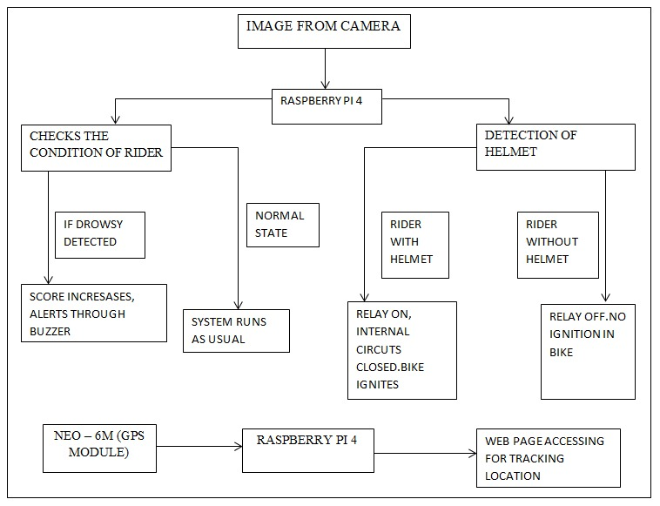
FRAME WORK

Slide 17
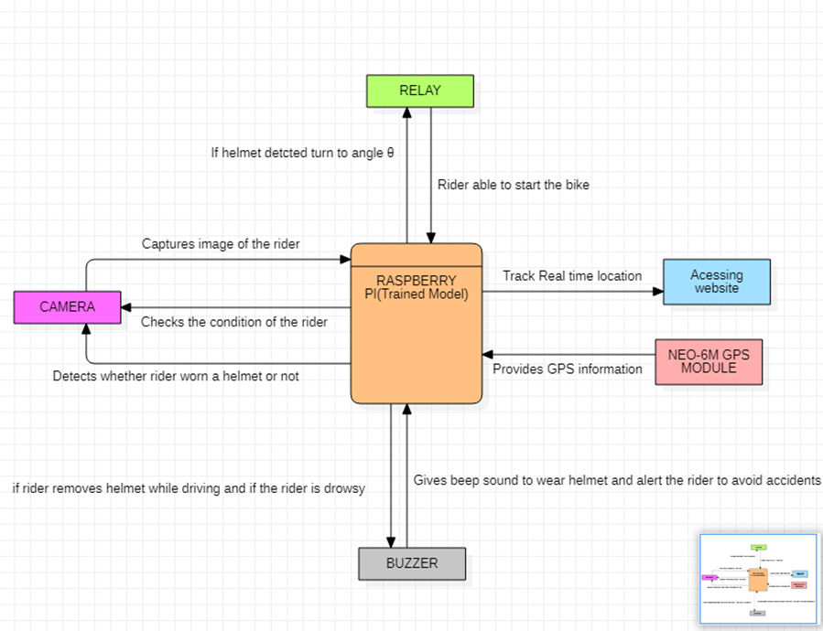
UML DIAGRAM

Slide 18
HARDWARE TOOLS
Raspberry Pi 4 - Model B
Relay
Night Vision Camera
Buzzer
Neo-6M GPS Module
LED

Slide 19
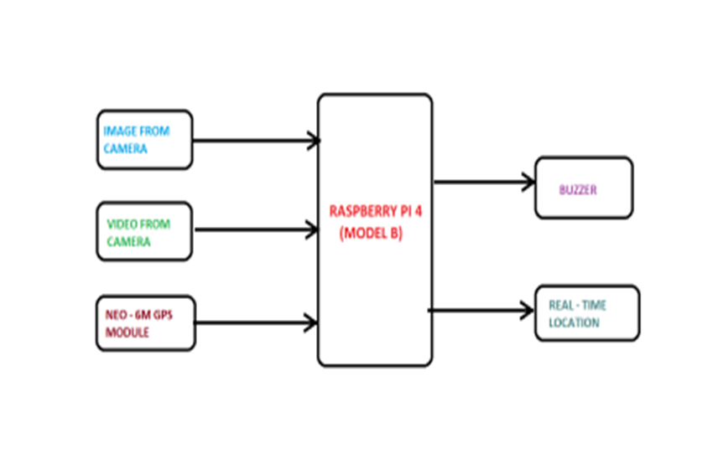
BLOCK DIAGRAM

Slide 20
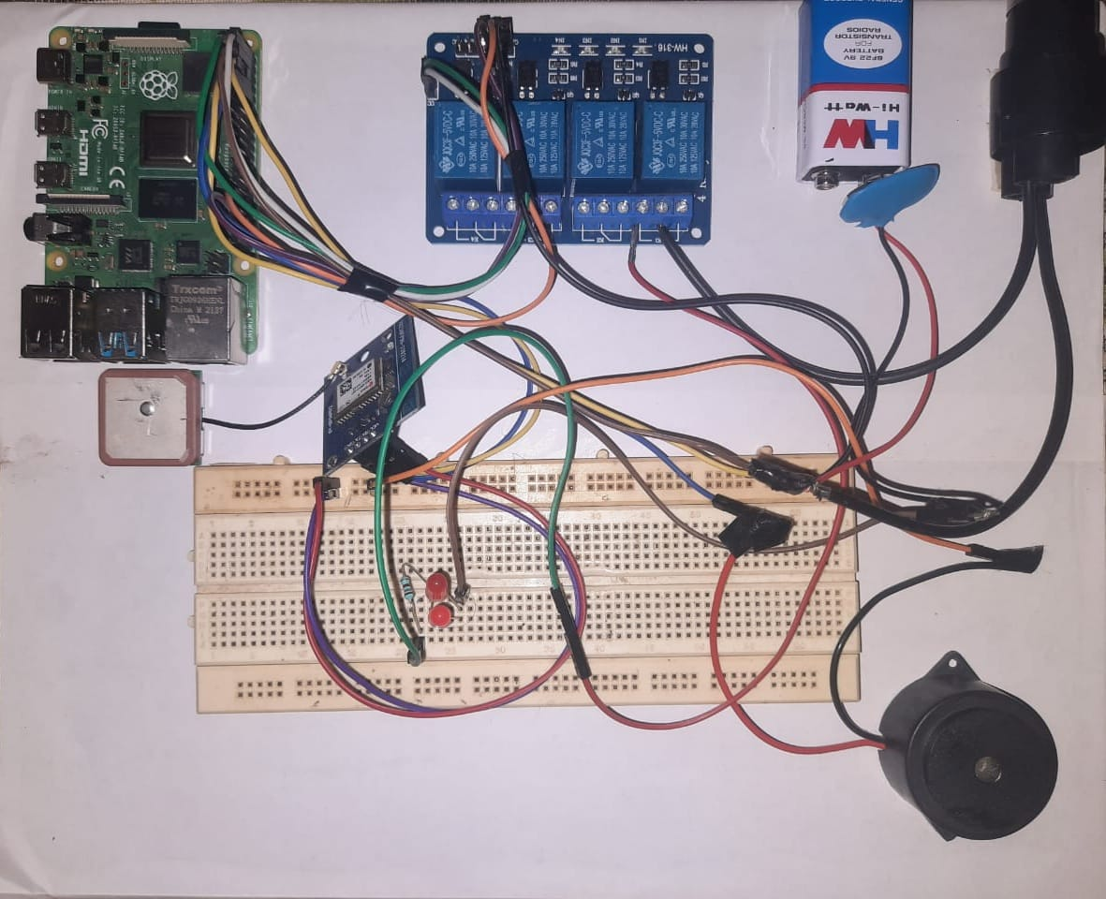
OVERVIEW OF SYSTEM

Slide 21
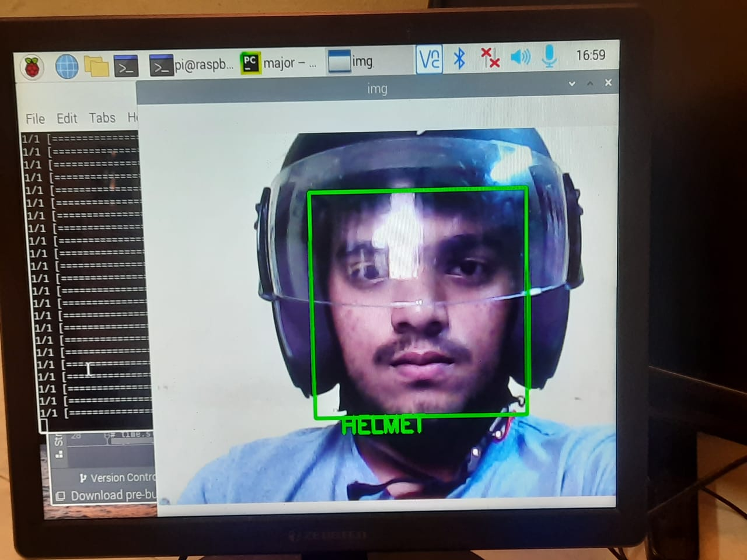
RESULTS
Helmet Detection Relay on LED Flickering
No Helmet Detection Relay off No flickering in LED

Slide 22
Open eyes detection Closed eyes detection
Real-time location application

Slide 23
CONCLUSION
By the end of the project we will be able to develop new features in the motorcycle in which the ignition depends on the driver’s helmet, alerts the driver at right time to prevent mishappening or accidents, and can track the location of the bike anytime anywhere.

Slide 24
REFERENCES
https://www.researchgate.net/publication/336889627_Detecting_motorcycle_helmet_use_with_deep_learning
https://www.researchgate.net/publication/301585955_Automatic_Detection_of_Bike-riders_without_Helmet_using_Surveillance_Videos_in_Real-time
https://ieeexplore.ieee.org/document/6216768
https://www.researchgate.net/publication/286840650_Driver_drowsiness_detection_through_HMM_based_dynamic_modeling
https://www.researchgate.net/publication/342694207_Live_Tracking_System
https://www.researchgate.net/publication/352559892_GPS_Based_Vehicle_Tracking_System

Slide 25
THANK YOU!!

